Slide 1

Computational Logic
Microsoft Teams platform – Logic-IE 2024-2025 team
Objectives:
The aim of the course is the presentation of the logical foundations of computer science:
propositional calculus and predicate calculus, theorem proving methods,
Boolean algebras and Boolean functions, logic circuits.
Additionally, notions related to numbers representation are
introduced.

Slide 2
Competencies
to use numeration systems and internal numbers representations;
to understand the theoretical aspects of classical logics;
to understand classical logics from a computational perspective (apply specific proof methods);
to model human reasoning and mathematical reasoning using propositional logic and predicate logic;
to understand logic circuits and to simplify them using specific simplification methods for Boolean functions.

Slide 3
Methods
lectures, exercises, individual study;
specific bibliographic materials are used:
books, articles, internet resources;
individual homework
optional homework

Slide 4
Content
I. Numeration systems, numbers representations
==> prerequisite for the discipline: Computer Architecture
II. Classical logics: propositional and predicate logics
==> prerequisite for the disciplines:
Logic programming, Artificial Intelligence,
Automated theorem proving systems.
III. Boolean algebras, Boolean functions and logic circuits

Slide 5
Evaluation - share in the final grade (%)
Midterm exam (written exam in the sixth week during the seminar): 20%
subjects from:
operations and conversions in different numeration bases
internal representations of integer and real numbers
grade >= 5
Seminars’ activity: 20%
individual homework and presentation of the solved exercises during seminars
subjects from propositional and predicate logics and circuits
grade >= 5

Slide 6
Evaluation - share in the final grade (%)
Final exam (theory and exercises): 60%
written paper (during the exam session)
subjects from: propositional logic, predicate logic,
logic circuits
grade>= 4.5
Optional homework: 10% (increases the final grade)
Solve/propose a set of exercises that model mathematical reasoning and common-sense reasoning, using the studied proof methods for propositional and predicate logics.

Slide 7
Rules for seminars
Attendance at the seminars is mandatory for
at least 75% (minimum 10.5 seminars out of 14)

Slide 8
IMPORTANT
It is not allowed to register the didactic activities!
According to LEN 2011, the registration by any procedure of the didactic activity can be done only with the consent of the teacher.

Slide 9
I. Numeration systems, numbers representations
Numeration systems
definitions, representation and operations (addition, subtraction, multiplication, division) of numbers in a base b.
conversions between two bases, using three methods, for integer and rational numbers.
Numbers’ representation
representation for unsigned integers, operations.
codes (direct, inverse, complementary) for signed integers and subunitary numbers.
representations of real numbers:
fixed-point representation, floating-point representation.

Slide 10
References
F. Boian: Bazele Matematice ale Calculatoarelor, Editura Presa Universitara Clujeana, 2002.
M. Cocan, B. Pop: Bazele matematice ale sistemelor de calcul (chapter 1), Editura Albastra, Cluj-Napoca, 2001.
A. Vancea, F. Boian, D.Bufnea, A.Gog, A.Darabant, A.Sabau: Arhitectura calculatoarelor. Limbajul de asamblare 80x86, (chapter 1), Editura Risoprint, Cluj-Napoca, 2005.

Slide 11
II. Classical logics: propositional logic and predicate logic
Propositional calculus and predicate calculus are
presented from an algebraic point of view and as
deductive systems (computational perspective).
Theorem proving methods are used to decide whether a
statement (conjecture) is a logical consequence of a
set of statements (axioms and hypotheses).
Aim: formalization of human and mathematical
reasoning using these classical logics.

Slide 12
LOGIC
LOGIC:
the science that studies the principles
of reasoning and valid inference.
Philosophical logic and mathematical logic are commonly associated with deductive reasoning, which determines whether the truth of a conclusion can be obtained for an inference (deductive) rule, based solely on the truth of the set of premises (hypotheses).

Slide 13
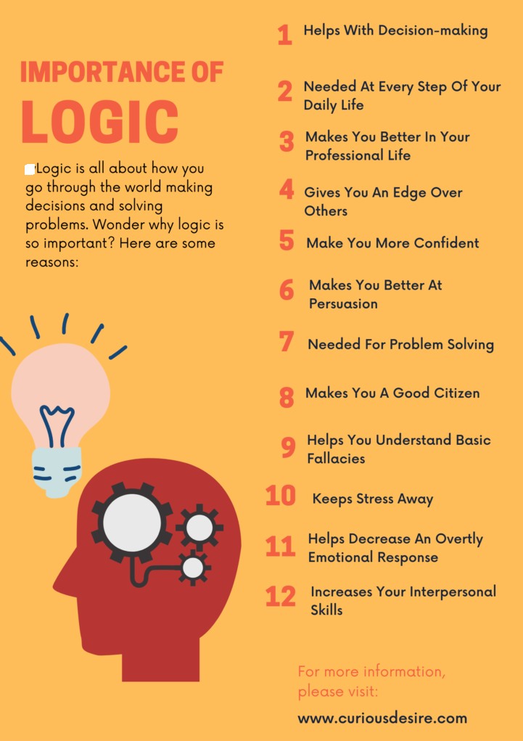

Slide 14
Timeline of research in logic
450 B.C. Stoics - propositional logic (PL), inference
322 B.C. Aristotle - quantifiers, syllogism rule: dominant
model of correct argumentation
1646 -1716 Leibniz – the founder of symbolic logic, he proposed
a general decision procedure to check the validity of formulas
1847 George Boole – algebras, formalization of propositional logic
1847 Augustus De Morgan: formal logic
1879 Gottlob Frege – predicate or first-order logic (FOL)
1889 Peano - 9 axioms for natural numbers
1920 Hilbert‘s program
1921 Emil Post- truth tables, 1922 Wittgenstein - proof by truth tables

Slide 15
Timeline of research in logic (contd.)
1929 Gödel completeness theorem of FOL
1930 Herbrand - a proof procedure for FOL based on propositionalization
1931 Gödel incompleteness theorems for the consistency of Peano axioms
1936 Gentzen - a proof for the consistency of Peano axioms in set theory
1936 Church and Turing: undecidability of FOL
1954 Davis - first machine-generated proof
1955 Beth - Semantic Tableaux
1957 Newell - First machine-generated proof in Logic Calculus
1958 Prawitz - First prover for FOL
1959 Gilmore, Wang - more provers
1960 Davis - Putnam Procedure
1963 Robinson - Unification, resolution
1968 R.Smullyan – Semantic tableaux proof method

Slide 16
Propositional and predicate logics
Syntax: connectives, quantifiers, terms, atoms, clause, literal, formulas.
The formal system associated to propositional/predicate logic.
Semantics of propositional/predicate logic: interpretation, model, valid/consistent/inconsistent formula, logical consequence.
Normal forms in propositional and predicate logics.
Theorem of soundness, completeness for propositional/predicate logic; non-contradiction, coherence and decidability of propositional logic, semi-decidability of predicate logic.
Semantic tableaux method – a semantic and refutation proof method.
Resolution method – a direct and refutation proof method.
Formalization of common-sense and mathematical reasoning using propositional and predicate logic.

Slide 17
Propositional logic
Logical propositions are models of propositional assertions
from natural language, which can be true or false.
P: It is sunny.
Q: It is hot outside.
R: I go to the swimming pool.
S: If it is sunny and it is hot outside then
I will go to the swimming pool.
S: P /\ Q → R
“Theorem proving”:
From P,Q,S (hypotheses) can we deduce (infer) R (conjecture)?

Slide 18
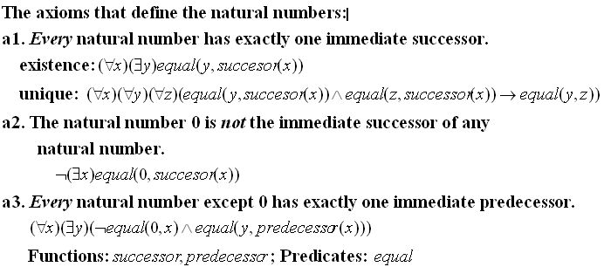
Predicate (first-order) logic

Slide 19
Modelling reasoning using predicate logic
Hypotheses:
H1. If x is perpendicular to y then x intersects y.
H2. If x is parallel to y then x does not intersect y.
H3. If x is perpendicular to y and z is perpendicular to y
then x is parallel to z.
H4. d1 is perpendicular to d.
H5. d is perpendicular to d2.
Conclusion: C. d1 does not intersect d2.
Check whether the conclusion C is derivable from the set of hypotheses.
Succession to the British throne – common-sense human reasoning
Hypotheses:
H1: If x is the king and y is his oldest son, then y can become the king. H2: If x is the king and y defeats x, then y will become the king.
H3: RichardIII is the king.
H4: HenryVII defeated RichardIII.
H5: HenryVIII is HenryVII’s oldest son.
Conclusion C: Can HenryVIII become the king?

Slide 20
Types of logics
classical logics:
propositional logic
predicate (first order) logic
modal and temporal logics
multivalued and fuzzy logics
nonmonotonic logics

Slide 21
Automated Theorem Proving (ATP)
deals with the development of computer programs which show that some statement (the conjecture) is a logical consequence of a set of statements (the axioms and the hypotheses).
Dedicated (educational) automated theorem provers
3TAP, pTAP, leanTAP, Cassandra (semantic tableaux)
OTTER, PCPROVE, AMPHION, Jape (resolution)
HERBY (semantic trees + Herbrand theorem)
Implementations in: PROLOG, LISP, C/C++,…

Slide 22
ATP systems in mathematics
EQP. In 1933 Herbert Robbins conjectured that a particular group of axioms forms a basis for Boolean algebra, but neither he nor anyone else could prove this. The proof was found in October 10, 1996, after about 8 days of search by EQP.
Otter - used to prove several results in quasi-groups.
Geometry Expert has been used to obtain new results in Euclidean geometry.

Slide 23
ATP for software generation
the KIDS system developed at Kestrel Institute
used to derive scheduling algorithms that have outperformed currently used algorithms
provides intuitive, high level operations for transformational development of programs from specifications.
the AMPHION project, sponsored by NASA
used to determine appropriate subroutines combined to produce programs for satellite guidance.
by encapsulating usable functionality in software components, and then reusing those components, AMPHION can develop software in less time than human programmers.

Slide 24
ATP for software verification
The Karlsruhe Interactive Verifier (KIV)
verifies a large range of software applications: implementation of set functions, tree and graph representation and manipulation.
used for industrial application: a software controlled railway switch, safe command transfer in a space vehicle, and supervision of neutron flow in a nuclear reactor.
PVS is a verification system
used in various applications: diagnosis and scheduling algorithms for fault tolerant architectures, and requirements specification for portions of the space shuttle flight control system.
NASA uses ATP to certify safety properties of aerospace software that has been automatically generated from high-level specifications.

Slide 25
ATP for hardware verification
Hardware verification is the largest industrial application of ATP.
IBM, Intel, and Motorola are among the companies that employ ATP technology for verification.
ACL2 system - used to obtain a proof of the correctness of the floating point divide code for AMD's PENTIUM-like AMD5K86 microprocessor
ANALYTICA - used to verify a division circuit that implements the floating point standard of IEEE.
HOL system - used at Bell Laboratories for hardware verification.

Slide 26
References
M. Ben-Ari: Mathematical Logic for Computer Science, Ed. Springer, 2001
M. Clarke: Logic for Computer Science, Ed. Eddison-Wesley 1990.
M. Fitting: First-order logic and Automated Theorem Proving, Ed. Springer Verlag, 1990.
Mihaela Malita, Mircea Malita: Bazele Inteligentei Artificiale, Vol. I, Logici propozitionale, Ed. Tehnica, Bucuresti, 1987 – library.
M. Lupea, A. Mihiş: Logici clasice şi circuite logice. Teorie şi exemple, Editura Albastra, edition I- 2008, edition II– 2009, edition III- 2011.
M. Lupea, A. Mihis: A Computational Approach to Classical Logics and Circuits, Presa Universitara Clujeana, Cluj-Napoca, edition II-2016 .
L.C. Paulson: Logic and Proof, Univ. Cambridge, 2000, on-line course.
M. Possega: Deduction Systems, Inst. of Informatics, 2002, on-line course.
D.Tatar: Bazele matematice ale calculatoarelor, edition 1999- library.

Slide 27
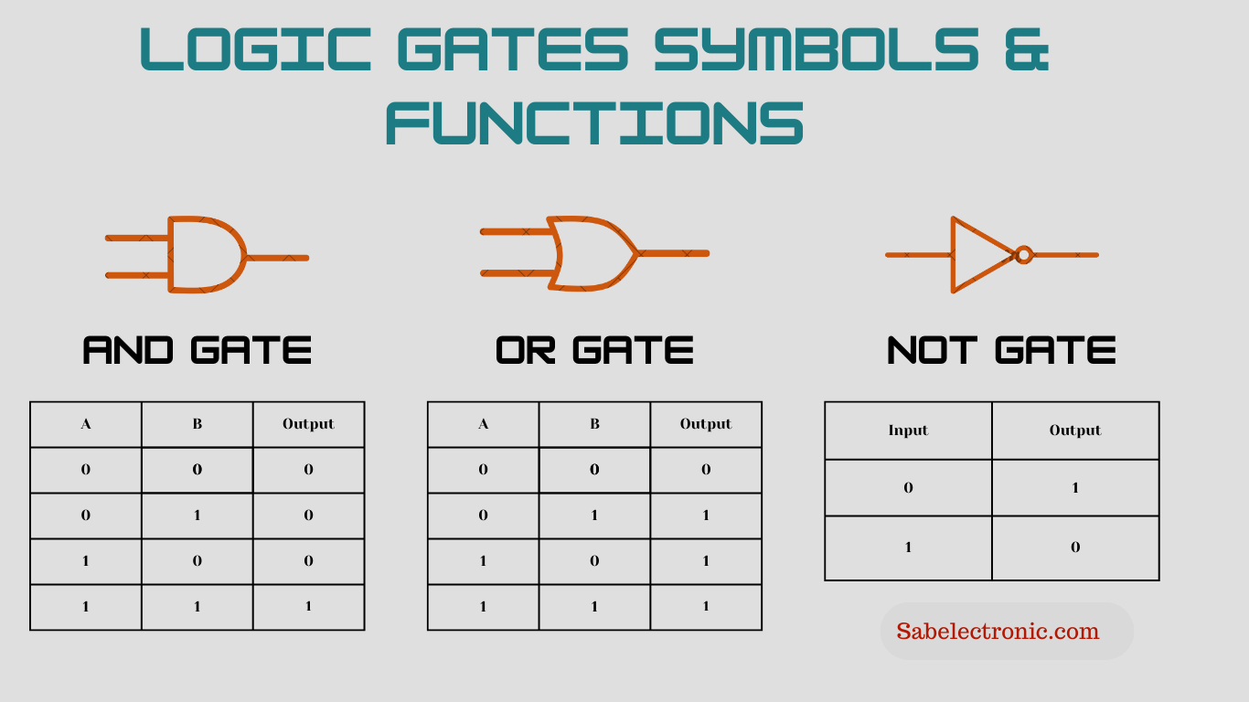
III. Boolean algebras, Boolean functions Logic circuits

Slide 28
III. Boolean algebras, Boolean functions Logic circuits
In 1938 Claude Shannon proved that a two-valued binary Boolean algebra can describe the operations of two-valued electrical switching circuits.
Propositional logic is used to minimize the number of gates in a circuit, and to show the equivalence of combinational circuits.
Grigore Moisil (1906-1973) invented the three-stable circuits and had important contributions in the fields of algebraic logic and differential equations. Moisil used propositional logic to minimize Boolean functions.
In modern times Boolean algebras and Boolean functions are indispensable in the design of computer chips and digital circuits.

Slide 29
III. Boolean algebras, Boolean functions and Logic circuits (contd.)
Boolean algebras: definition, properties, principle of duality, example.
Boolean functions: definitions, maxterms, minterms, canonic disjunctive/conjunctive forms.
Simplification of Boolean functions:
definitions: maximal monoms, central monoms, factorization;
Veitch-Karnaugh diagrams method
Quine’s analytical method, Moisil’s algebraic method.
Logic circuits
definitions, representations for basic gates (“and”, “or”, “not”) and derived gates (“xor”, “nand”, “nor”)
examples of logic circuits: adder, subtractor, decoder, encoder, comparator

Slide 30
References
M. Cocan, B. Pop: Bazele matematice ale sistemelor de calcul (chapter 2), Editura Albastra, Cluj-Napoca, 2001 – library.
M. Lupea, A. Mihiş: Logici clasice şi circuite logice. Teorie şi exemple., Editura Albastra, edition I -2008, edition II - 2009, edition III - 2011.
M. Lupea, A. Mihis: A Computational Approach to Classical Logics and Circuits, Editura Universitara Clujeana, second edition, 2016.
D.Tatar: Bazele matematice ale calculatoarelor, edition 1999, library.

